Slide 1
Entity Framework Core
Entity Framework (EF) Core is a lightweight, extensible, open source and cross-platform version of the popular Entity Framework data access technology.
EF Core can serve as an object-relational mapper (O/RM), which:
Enables .NET developers to work with a database using .NET objects.
Eliminates the need for most of the data-access code that typically needs to be written.
EF Core supports many database engines, see Database Providers for details.

Slide 2
Database Providers
NuGet Package | Supported database engines | Maintainer / Vendor | Notes / Requirements | Built for version | Useful links
Microsoft.EntityFrameworkCore.SqlServer | SQL Server 2012 onwards | EF Core Project (Microsoft) |  | 5.0 | docs
Microsoft.EntityFrameworkCore.Sqlite | SQLite 3.7 onwards | EF Core Project (Microsoft) |  | 5.0 | docs
Microsoft.EntityFrameworkCore.InMemory | EF Core in-memory database | EF Core Project (Microsoft) | Limitations | 5.0 | docs
Microsoft.EntityFrameworkCore.Cosmos | Azure Cosmos DB SQL API | EF Core Project (Microsoft) |  | 5.0 | docs
Npgsql.EntityFrameworkCore.PostgreSQL | PostgreSQL | Npgsql Development Team |  | 5.0 | docs
Pomelo.EntityFrameworkCore.MySql | MySQL, MariaDB | Pomelo Foundation Project |  | 5.0 | readme
MySql.EntityFrameworkCore | MySQL | MySQL project (Oracle) |  | 5.0 | docs
Oracle.EntityFrameworkCore | Oracle DB 11.2 onwards | Oracle |  | 5.0 | website
And Many More - Database Providers - EF Core | Microsoft Docs
Entity Framework Core can access many different databases through plug-in libraries called database providers.
Most database providers for EF Core are distributed as NuGet packages, and can be installed by using NuGet Package Manager

Slide 3
Versions of EF (ORM)
EF-EF6 2008-2013
EF Core 2016
EF Core 2 2017
EF Core 3 2019
EF Core 5 2020
EF Core 6 Nov 2021
EF Core 7 Nov 2022
EF Core 8 Nov 2023

Slide 4
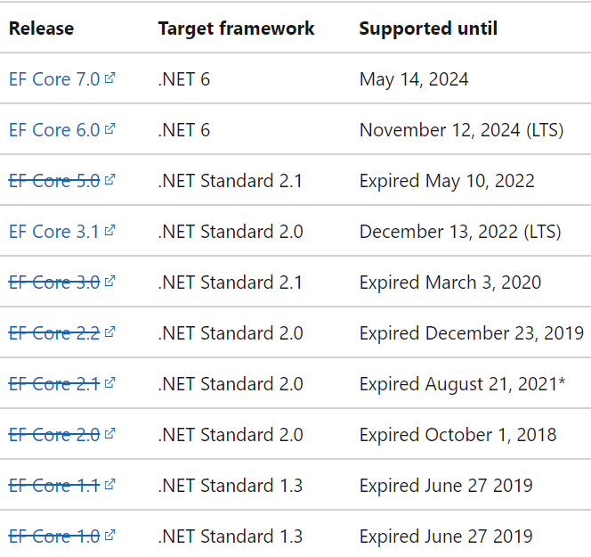
EF Core releases and support

Slide 5
.Net Core / ASP .Net Core & EF Core
.Net Core 3.1 + ASP .Net Core 3.1 + EF Core 5.0
.Net 5.0 + ASP .Net Core 5.0 + EF Core 5.0

Slide 6
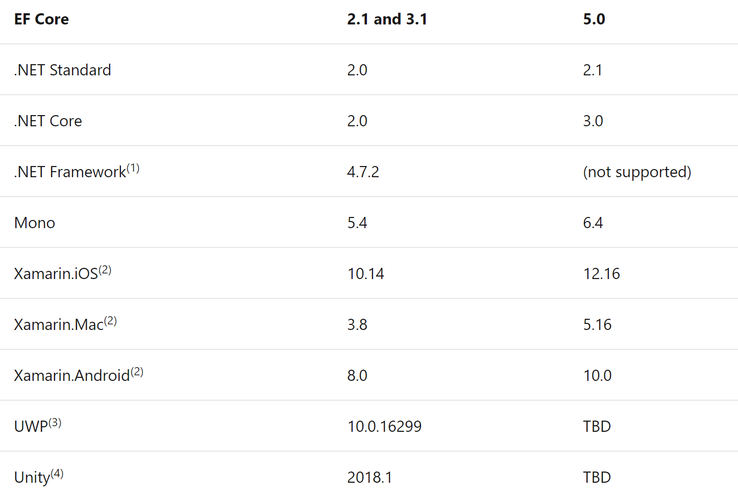
.Net Implementations Supported by EF Core

Slide 7
Setup
Visual Studio 2019
SQL Server LocalDB (Installs with VS 2019)
.Net 3.1 SDK
Add EF Core 5.0 using Nuget Package

Slide 8
EF Core Basics
Database DbContext
Tables DbSet
Columns DataMembers in Domain Class
Install the provider based on the DB Server you want your application to connect to.
Microsoft.EntityFrameworkCore.SqlServer – Install using Nuget

Slide 9
Query Execution
The following description is a high-level overview of the process each query goes through.
The LINQ query is processed by Entity Framework Core to build a representation that is ready to be processed by the database provider
The result is cached so that this processing does not need to be done every time the query is executed
The result is passed to the database provider
The database provider identifies which parts of the query can be evaluated in the database
These parts of the query are translated to database-specific query language (for example, SQL for a relational database)
A query is sent to the database and the result set returned (results are values from the database, not entity instances)
For each item in the result set
If the query is a tracking query, EF checks if the data represents an entity already in the change tracker for the context instance
If so, the existing entity is returned
If not, a new entity is created, change tracking is set up, and the new entity is returned
If the query is a no-tracking query, then a new entity is always created and returned

Slide 10
States of Entity
Attached (Tracking is On)
Unchanged
Added
Modified
Deleted
Detached (NoTracking)

Slide 11
What we covered in EF Core Session
Install EF Core, Provider, Tools
EF Core Migrations
Scaffold DB Context from Existing DB
Data Annotation and Fluent API’s
Defining Relationships
Interacting With Data Model and Logging
Bulk Operations
Simple Interaction – Get, Insert Update, Delete
Change Tracking
Related Interaction
Raw SQL and Stored Procedures
Db Concurrency Exception

Slide 12
What is .NET or .NET Core?
Understanding the details (.NET 5)

Slide 13
What is .NET?
.NET is a free, cross-platform, open-source developer platform for building many different types of applications.
DEVELOPER PLATFORM – Languages + Libraries
With .NET, you can use multiple languages, editors, and libraries to build for web, mobile, desktop, games, and IoT.
You can write .NET apps in C#, F#, or Visual Basic.
C# is a simple, modern, object-oriented, and type-safe programming language.
F# is a cross-platform, open-source, functional programming language for .NET. It also includes object-oriented and imperative programming.
Visual Basic is an approachable language with a simple syntax for building type-safe, object-oriented apps.

Slide 14
Cross Platform
Whether you're working in C#, F#, or Visual Basic, your code will run natively on any compatible OS.
Different .NET implementations handle the heavy lifting for you:
.NET Core is a cross-platform .NET implementation for websites, servers, and console apps on Windows, Linux, and macOS. (Write Once, Run Anywhere)
.NET Framework supports websites, services, desktop apps, and more on Windows. (Only Windows O.S.)
Xamarin/Mono is a .NET implementation for running apps on all the major mobile operating systems. (.NET for Mobile)
Universal Windows Platform (UWP) UWP is an implementation of .NET that is used for building modern, touch-enabled Windows applications and software for the Internet of Things (IoT).

Slide 15
One consistent API
.NET Standard is a base set of APIs that are common to all .NET implementations.
.NET Standard was to establish greater uniformity in the .NET ecosystem.
Each implementation can also expose additional APIs that are specific to the operating systems it runs on.
For example, .NET Framework is a Windows-only .NET implementation that includes APIs for accessing the Windows Registry.

Slide 16
.NET implementations includes
One or more runtimes. Examples: .NET Framework CLR, .NET 5 CLR.
A class library. Examples: .NET Framework Base Class Library, .NET 5 Base Class Library.
Optionally, one or more application frameworks. Examples: ASP.NET, Windows Forms, and Windows Presentation Foundation (WPF) are included in the .NET Framework and .NET 5.
Optionally, development tools. Some development tools are shared among multiple implementations.

Slide 17
SDK and runtimes (Libraries)
.NET SDK is a set of libraries and tools for developing and running .NET applications.
When you download .NET, you can choose the SDK or a runtime.
Install a runtime on a machine that you want to prepare for running .NET apps.
Install the SDK on a machine that you want to use for development.
When you download the SDK, you automatically get the runtimes with it.

Slide 18
SDK Installation Includes
The .NET CLI. Command-line tools that you can use for local development and continuous integration scripts.
The dotnet driver. A CLI command that runs framework-dependent apps.
Roslyn and F# programming language compilers.
The MSBuild build engine.
The .NET runtime. Provides a type system, assembly loading, a garbage collector, native interop, and other basic services.
Runtime libraries. Provides primitive data types and fundamental utilities.
The ASP.NET Core runtime. Provides basic services for internet-connected apps, such as web apps, IoT apps, and mobile backends.
The desktop runtime. Provides basic services for Windows desktop apps, including Windows Forms and WPF.

Slide 19
Runtime Installation Includes
Optionally, the desktop or ASP.NET Core runtime.
The .NET runtime. Provides a type system, assembly loading, a garbage collector, native interop, and other basic services.
Runtime libraries. Provides primitive data types and fundamental utilities.
The dotnet driver. A CLI command that runs framework-dependent apps.

Slide 20
Runtime Libraries
.NET has an expansive standard set of class libraries, known as runtime libraries, framework libraries, or the base class library (BCL).
These libraries provide implementations for many general-purpose and workload-specific types and utility functionality.
Some examples of types defined in the .NET runtime libraries:
Primitive types, such as System.Boolean and System.Int32.
Collections, such as System.Collections.Generic.List<T>
Data types, such as System.Data.DataSet and System.Data.DataTable.
Network utility types, such as System.Net.Http.HttpClient.
File and stream I/O utility types, such as System.IO.FileStream and System.IO.TextWriter.
Serialization utility types, such as System.Text.Json.JsonSerializer.
High-performance types, such as System.Span<T>.
More Details - https://github.com/dotnet/runtime/tree/main/src/libraries

Slide 21
Extensions to the runtime libraries
NuGet package | Documentation
Microsoft.Extensions.Hosting | Application lifetime management (Generic Host)
Microsoft.Extensions.DependencyInjection | Dependency injection (DI)
Microsoft.Extensions.Configuration | Configuration
Microsoft.Extensions.Logging | Logging
Microsoft.Extensions.Options | Options pattern
Libraries for some commonly used application functionality aren't included in the runtime libraries but are made available in NuGet packages, such as the following:
More Details
https://github.com/dotnet/extensions

Slide 22
NuGet
NuGet is an open-source package manager designed for .NET.
To extend functionality, Microsoft and others maintain a healthy package ecosystem built on .NET Standard.
NuGet is a package manager built specifically for .NET that contains over 90,000 packages.

Slide 23
Data Access
.NET provides an Object/Relational Mapper (ORM) and a way to write SQL queries in code.
Entity Framework Core
Entity Framework (EF) Core is an open source and cross-platform data-access technology that can serve as an ORM.
LINQ
Language-integrated query (LINQ) lets you write declarative code for operating on data.
ADO .NET
ADO.NET provides consistent access to data sources such as SQL Server and XML, and to data sources exposed through OLE DB and ODBC.

Slide 24
CI/CD
MSBuild and the .NET CLI can be used with various continuous integration tools and environments, such as:
GitHub Actions
Azure DevOps
CAKE
FAKE

Slide 25
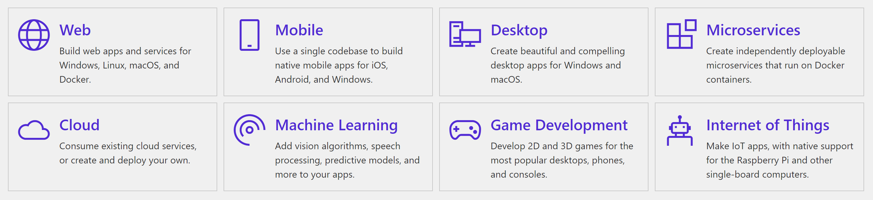
Types of apps with .NET

Slide 26
Active community and open-source
.NET is open source and under the .NET Foundation. The .NET Foundation is an independent organization to foster open development and collaboration around the .NET ecosystem.
Because .NET is open source, you can join the thousands of developers and companies already contributing to the .NET platform.
100,000+ Open-Source contributions
3,700+ Open-Source company contributors

Slide 27
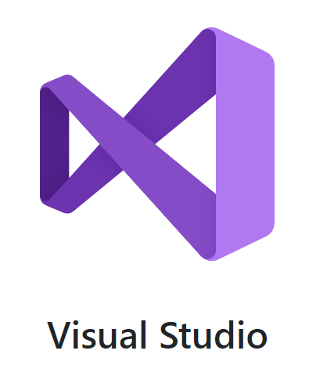
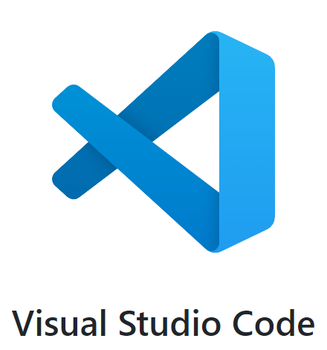
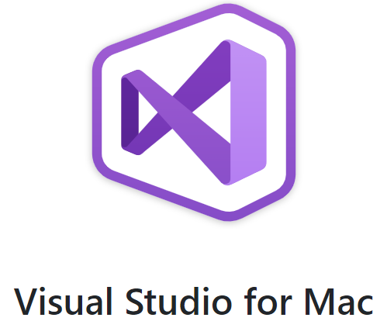

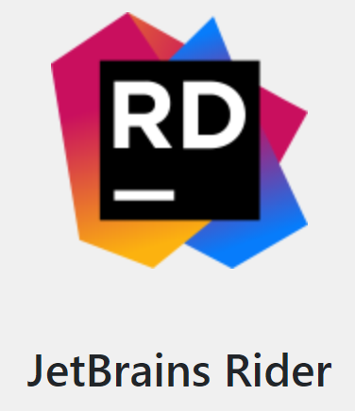
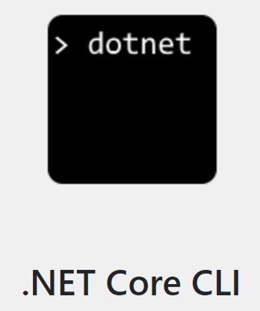
Tools
The Visual Studio product family provides a great .NET development experience on Windows, Linux, and macOS.
The Visual Studio Marketplace has thousands of editor extensions from Microsoft and others.
If you prefer to use a different editor, there are .NET command-line tools and plug-ins for many popular editors.

Slide 28
Download .NET
For Windows
.NET 5.0 - .NET Downloads (Linux, macOS, and Windows)
.NET Core 3.1 - .NET Downloads (Linux, macOS, and Windows)
.NET Framework 4.8 - .NET Framework Downloads
For Linux, macOS & Docker
Download .NET

Slide 29
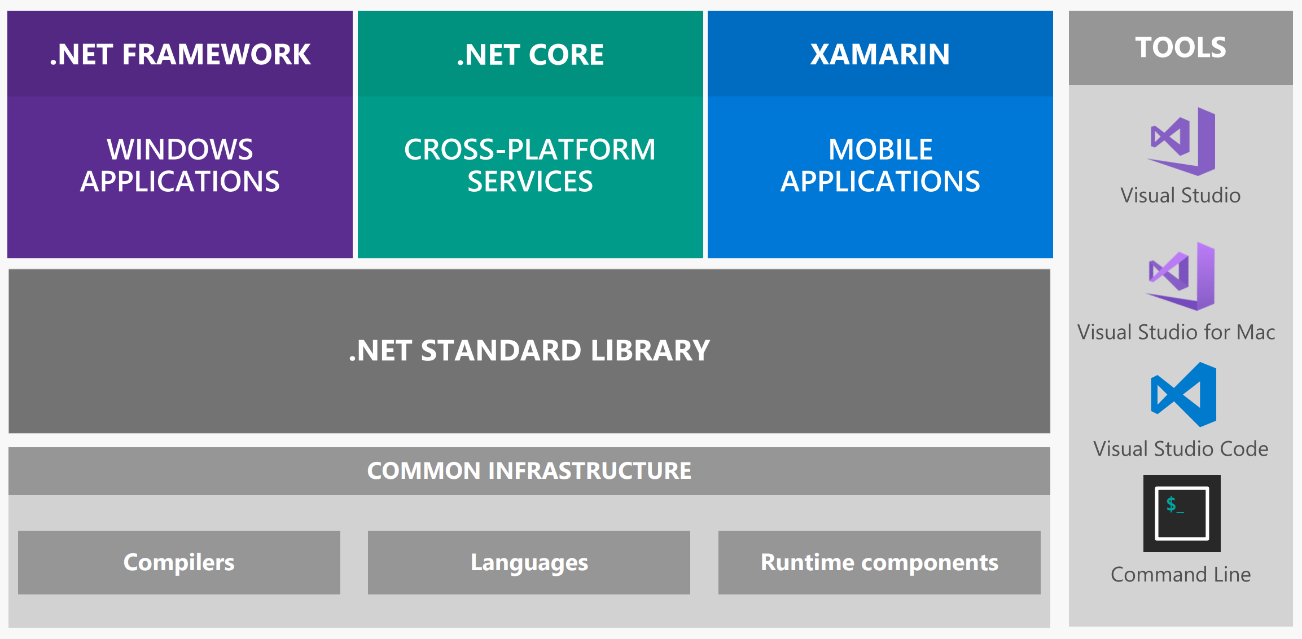
.Net – The Big Picture

Slide 30
Create a Console Application
Using Visual Studio 2019
Using Visual Studio Code
Using dotnet cli

Slide 31
.NET CLI commands
Some basic commands:
new
build
run
migrate
clean
Many More..
More Details on - .NET CLI | Microsoft Docs

Slide 32
What is ASP.NET?
ASP.NET is an open-source web framework, created by Microsoft, for building modern web apps and services with .NET.
ASP.NET is cross platform and runs on Windows, Linux, macOS, and Docker.
ASP.NET extends the .NET platform with tools and libraries specifically for building web apps.
These are some things that ASP.NET adds to the .NET platform:
Base framework for processing web requests in C# or F#
Web-page templating syntax, known as Razor, for building dynamic web pages using C#
Libraries for common web patterns, such as Model View Controller (MVC)
Authentication system that includes libraries, a database, and template pages for handling logins, including multi-factor authentication and external authentication with Google, Twitter, and more.
Editor extensions to provide syntax highlighting, code completion, and other functionality specifically for developing web pages

Slide 33
Application Types
ASP.NET allows you to build many types of web applications, including
Web pages
REST APIs
Microservices
Hubs that push real-time content to connected clients

Slide 34
.NET Generic Host
The ASP.NET Core templates create a .NET Core Generic Host
The Generic Host can be used with other types of .NET applications, such as Console apps.
A host is an object that encapsulates an app's resources, such as:
Dependency injection (DI)
Logging
Configuration
IHostedService implementations
In a web app, one of the IHostedService implementations is a web service that starts an HTTP server implementation.

Slide 35
.NET Generic Host
The host is typically configured, built, and run by code in the Program class. The Main method:
Calls a CreateHostBuilder method to create and configure a builder object.
Calls Build and Run methods on the builder object.
We can set up some convenient patterns for an application including those for dependency injection (DI), logging, and configuration.
It has since been generalized (from .NET Core 3.1) to support other scenarios, such as Windows services, Linux daemon services, or even a Console App.
It is available in Microsoft.Extensions.Hosting package.

Slide 36
What is ASP.NET Core?
ASP.NET is a popular web-development framework for building web apps on the .NET platform.
ASP.NET Core is the open-source version of ASP.NET, that runs on macOS, Linux, and Windows.
ASP.NET Core was first released in 2016
It is a re-design of earlier Windows-only versions of ASP.NET.
It's faster than other popular web frameworks in the independent TechEmpower benchmarks.

Slide 37
Advantages of ASP.NET Core
ASP.NET Core is designed to allow runtime components, APIs, compilers and languages evolve quickly, while still providing a stable and supported platform to keep apps running.
Multiple versions of ASP.NET Core can exist side by side on the same server.
ASP.NET Core provides various support lifecycle options to meet the needs of your app.
ASP.NET is open source on GitHub.
ASP.NET Core apps can be developed and run-on Windows, Linux, macOS, and Docker.
The ASP.NET Core runtime that your app runs on can be deployed as part of your app or installed centrally on your web server.
ASP.NET Core is also perfectly suited for Docker containers.

Slide 38

Understanding Patterns
Code Structuring

Slide 39
Foundational Architectural Principles

Slide 40
Important Design Principles
Dependency inversion
Separation of concerns
Single responsibility
DRY
Persistence ignorance

Slide 41

Dependency Inversion
Decoupling modules
Dependencies should be pointing to abstractions
Typically top to bottom
Helps with building more loosely-coupled applications

Slide 42
Typical Approach
Class A
Class B
Class C

Slide 43
Adding Dependency Inversion
Class A
Interface B
Interface C
Class B
Class C

Slide 44

Separation of Concerns
Split into blocks of functionality
Each covering a concern
More modular code
Encapsulation within a module
Typical layered application Easier to maintain

Slide 45

Single Responsibility
OO terminology
Each block should just have one single responsibility which it encapsulates
More, new classes are created
Can be extended to application-level
- Different layers have their own responsibility

Slide 46

DRY
(aka Don’t Repeat Yourself)
Less code repetition Easier to make changes

Slide 47
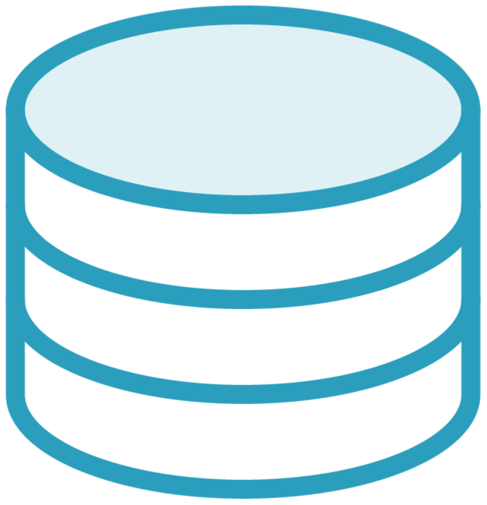
Persistence Ignorance
POCO
Domain classes shouldn’t be impacted by how they are persisted
Typically required base class or attributes

Slide 48
Understanding Clean Architecture

Slide 49



Different Types of Application Architecture
All-in-one architecture
Layered architecture
Clean architecture

Slide 50



All-in-one Architecture
File ➔ New Project
Contained typically in one (large) Visual Studio project
“Layers” are folders
Can be difficult to maintain

Slide 51




Layered Architecture
Split according to concern
Promote reuse
Easier to maintain
Pluggable

Slide 52
Typical Layered Architecture
Presentation layer
Business logic layer
Data access layer

Slide 53

Disadvantages of Layered Architecture
Still “coupling” between layers
Behaves as single application

Slide 54
Introducing
Clean Architecture
Based on design principles
Separate concerns
Create maintainable and testable application code

Slide 55
Variation on hexagonal and onion architecture
Introduced in 2012
Separation of concerns Loose coupling
Independent of “external” influences
UI
Database

Slide 56

Circular Design
Different circles for different “layers”
Application Core
Abstractions (high-level)
Interfaces and entities
Business logic at the center of the application (use-cases)
Agnostic to outer circles
Has no dependencies on external influences
User interface
Interfaces Entities
Core
Application Core
Infrastructure

Slide 57
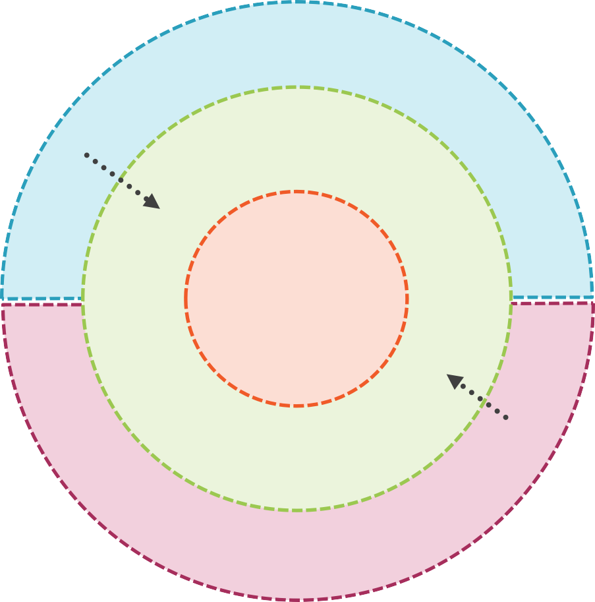
Understanding Clean Architecture
Outer circles are infrastructure (mechanisms)
Depends on Core
Implements interfaces from Core
Dependencies are inverted
Pointing inwards
UI
Depends on Core
User interface
Interfaces Entities
Application Core
Infrastructure

Slide 58

Understanding Clean Architecture
User interface
Interfaces Entities
Application Core Infrastructure

Slide 59


Two Important Principles
Dependency Inversion
Mediator

Slide 60
What Goes Where?
Core
Entities
Interfaces
Core
Infrastructure
Services
Exceptions
No dependency to any Infrastructure- related code or package
User interface
Interfaces Entities
Application Core
Infrastructure

Slide 61
What Goes Where?
Infrastructure
Data access (EF Core)
Logging
Identity
API Clients
File access
User interface
Interfaces Entities
Application Core Infrastructure

Slide 62
What Goes Where?
UI
API/MVC/Razor
Specific ASP.NET Core items
Middleware
Filters
Interact with services through Mediator
Loose coupling
Lightweight controllers
User interface
Interfaces Entities
Application Core
Infrastructure

Slide 63



Clean Architecture Benefits
Independent of UI or used frameworks
No knowledge of used database
Testable and maintainable

Slide 64
The end result…
Testable and maintainable application code
Not for every application though!

Slide 65
Requirements for Ticket Management App
Manage events
Overview of events in their categories
Orders for the different events

Slide 66
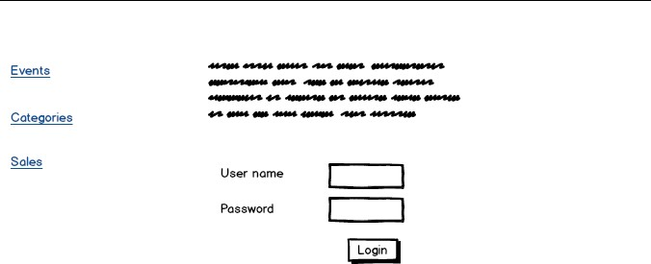
Wireframes for the Application

Slide 67
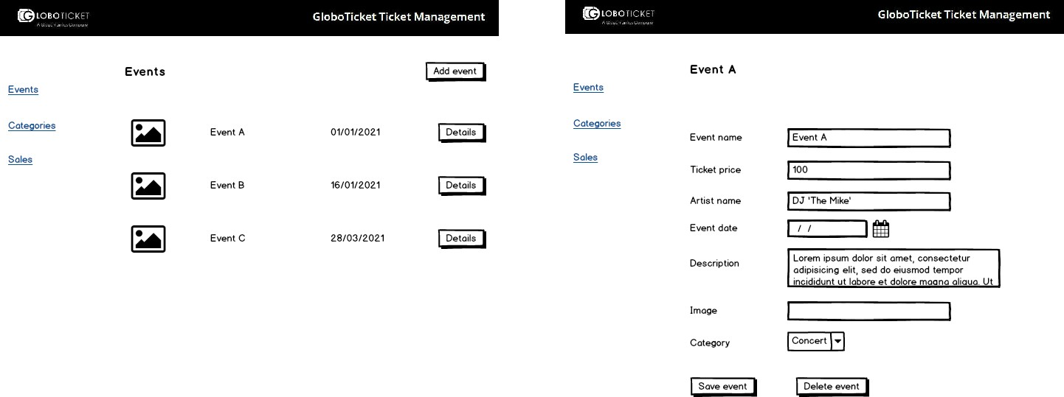
Event Management

Slide 68
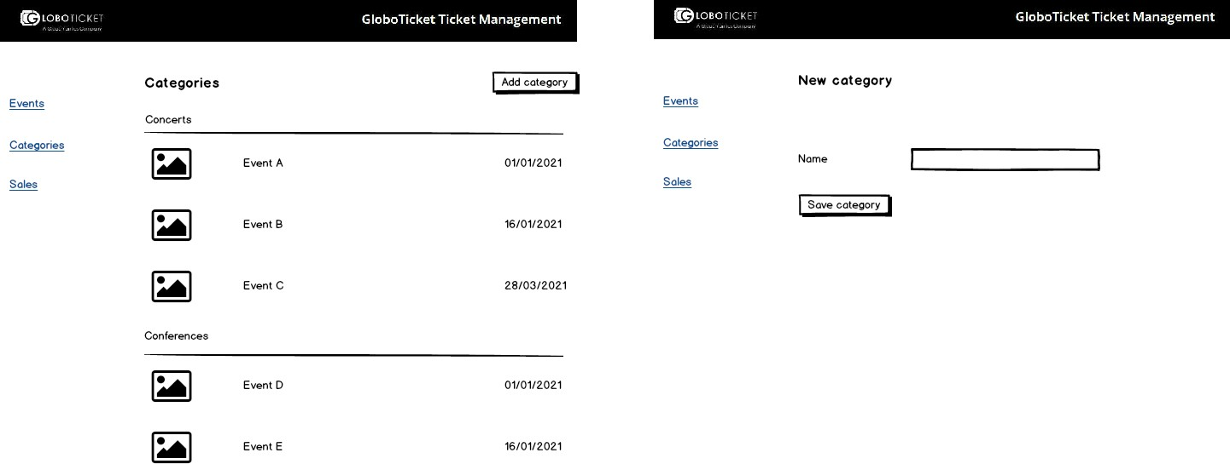
Category Management

Slide 69
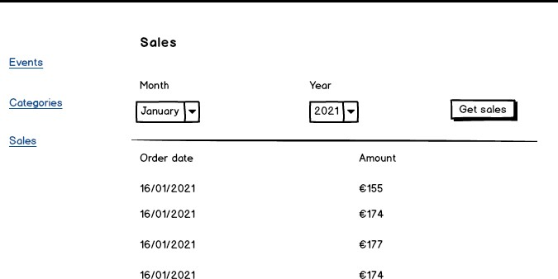
Ticket Sales

Slide 70
Creating the Domain Project

Slide 71

The Domain Project
User interface
Interfaces Entities
Application Core Infrastructure

Slide 72
Designing the Application Project

Slide 73

The Application Project
User interface
Interfaces Entities
Application Core Infrastructure

Slide 74

Achieving loose coupling in the application core
Contracts
Messaging

Slide 75

Contracts
Part of application core
Functionality is described in interfaces
Implemented in Core or Infrastructure

Slide 76

Using Repositories
Mediates between domain and data- mapping layer
Often used in combination with UOW

Slide 77
Using Repositories
Data access operations
Agnostic for rest of application
Generic methods
Specific repositories

Slide 78
Introducing a Mediator
Object that wraps what how objects need to interact
Avoid hard references from one object to the next
Help with communication from/to Core project objects
A
C
Mediator
B
D

Slide 79

Advantages of Using a Mediator
Changes can be handled easily
Easy to test the object

Slide 80
Using MediatR
Simple mediator implementation in .NET
github.com/jbogard/MediatR
Adding MediatR
Install-Package MediatR
Using
IRequest
IRequestHandler

Slide 81

Mapping from an Entity to a View Model
Entity
View model

Slide 82

Mapping Between Objects
AutoMapper library
Mapping from one type to another type

Slide 83

Reading and Writing Data
Same model is used to read and write data
Issues in larger applications
Different queries
Different object being returned
Complex logic for saving entities
Security may be different
Model may become too heavy

Slide 84


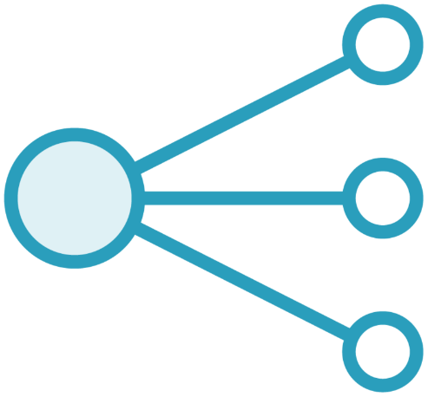
Adding Simple CQRS
Command-Query Responsibility Segregation
Different models
Commands to Create, Update & Delete
Queries to read data
Commands are task- based
Can be asynchronous

Slide 85

Advantages
Separation of concerns
Scaling
Security
Easy to make a change, no further impact
Disadvantages
Added complexity
Targeted at more complex applications

Slide 86
Creating a New Entity
IRequest
Command
Request Handler
Validation
Response

Slide 87
Validation Event.cs
public class Event: AuditableEntity
{
public Guid EventId { get; set; } [Required]
[StringLength(50)]
public string Name { get; set; }
public int Price { get; set; } [Required]
[StringLength(50)]
public string Artist { get; set; }
}

Slide 88

Adding Fluent Validation
Nuget package
Uses lambda expressions for validation rules
Can be used in Core project
RequestHandler
Part of the Feature folder

Slide 89

Returning Exceptions
Core should return own set of exceptions
Can be handled or transformed by consumer
Used exceptions
NotFoundException
BadRequestException
ValidationException

Slide 90
BROWSER
ANGULAR
REACT
BLAZOR
AJAX
API / MVC
JSON
CORE
ABSTRACTION
APPLICATION CORE
(ABSTRACTION)
DOMAIN (POCO)
INFRASTRUCTURE
IMPLEMENTATION

Slide 91
The Infrastructure Layer
User interface
All external or I/O components
Database
EF Core
DbContext
Files
Service bus
Service client
Logging
Interfaces Entities
Application Core
Infrastructure

Slide 92
The Infrastructure Layer
User interface
Configuration of technical frameworks
Implementations for contracts defined in the Core project
Reference to Core project
- Through dependency inversion and dependency injection, services get implemented
Interfaces Entities
Application Core
Infrastructure

Slide 93




Adding EF Core
NuGet packages
DbContext
Migrations
Startup registration

Slide 94
Repository implementations
Generic repository contract in Core project
Base repository implementation
Specific repositories if needed

Slide 95

New Request
We’ll need to send a mail when an event has been created.

Slide 96
Sending a Mail Through SendGrid
Infrastructure code to send a mail
NuGet package in Infrastructure
Interface in Core project
Implementation in Infrastructure

Slide 97
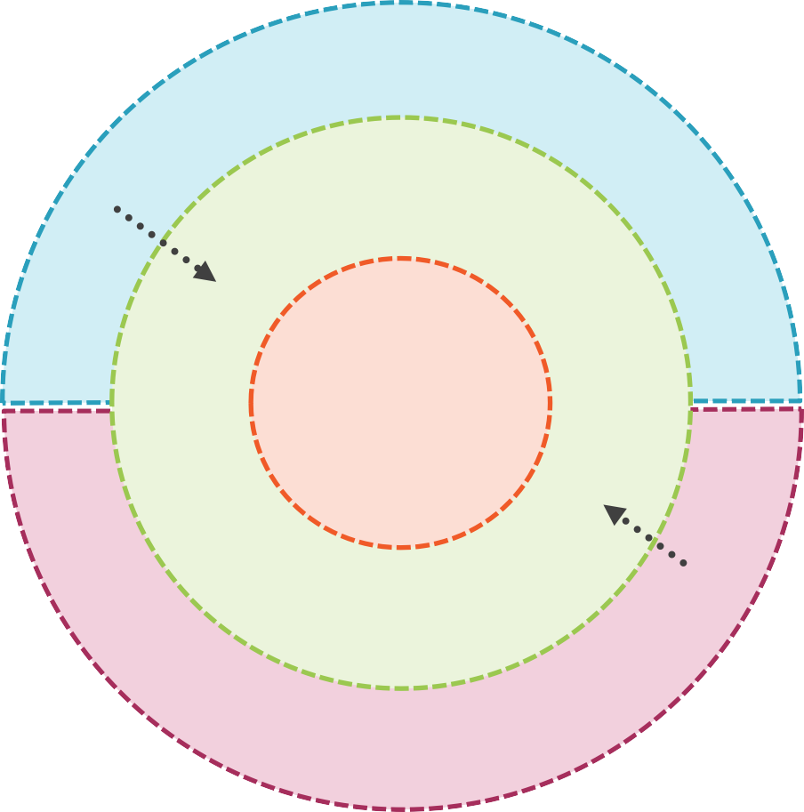
Bringing in the User Interface
User interface
In our case User Interface is an API
Interfaces Entities
Application Core Infrastructure

Slide 98
Simple Controllers Code Generally
Heavy on code
Validate incoming data using model binding
Execute logic
Create response type
Return status code and response

Slide 99
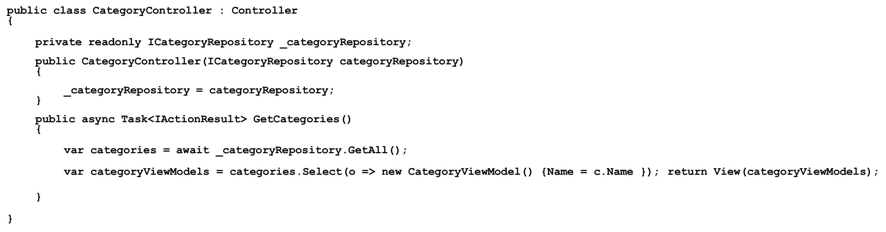
Simple but Heavy Controller

Slide 100
View services
Logic is moved to separate class
Called from controller
Views service connects with business logic
Returns DTO
Results in more lightweight controllers

Slide 101
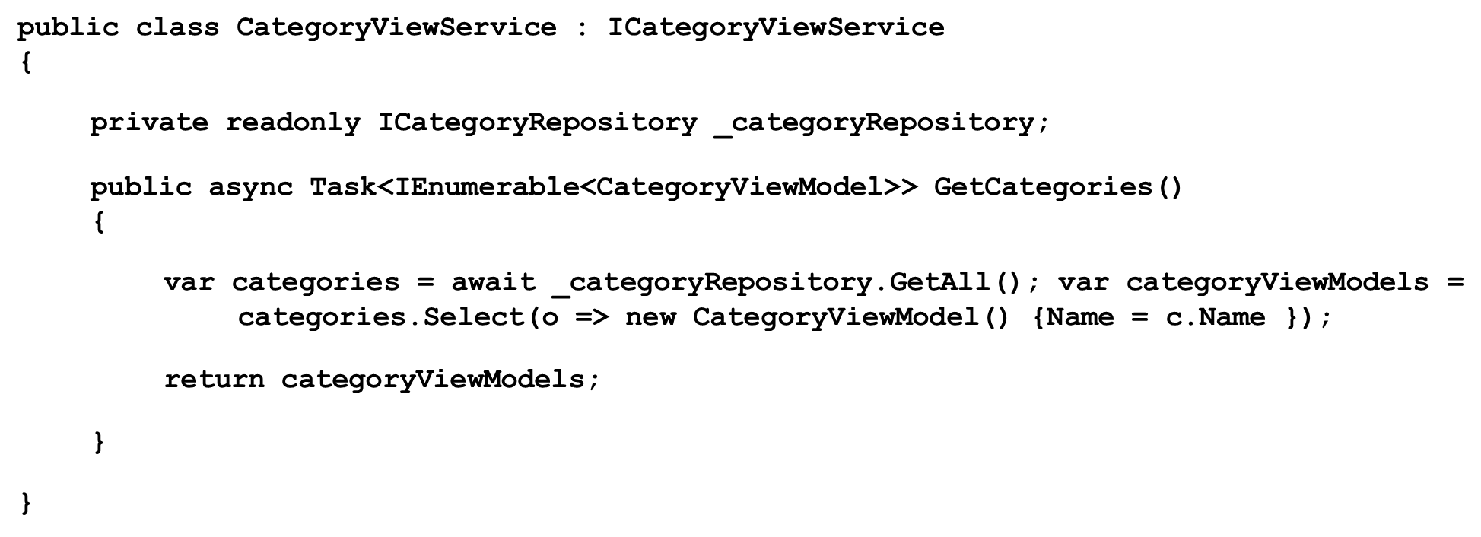
View Service

Slide 102
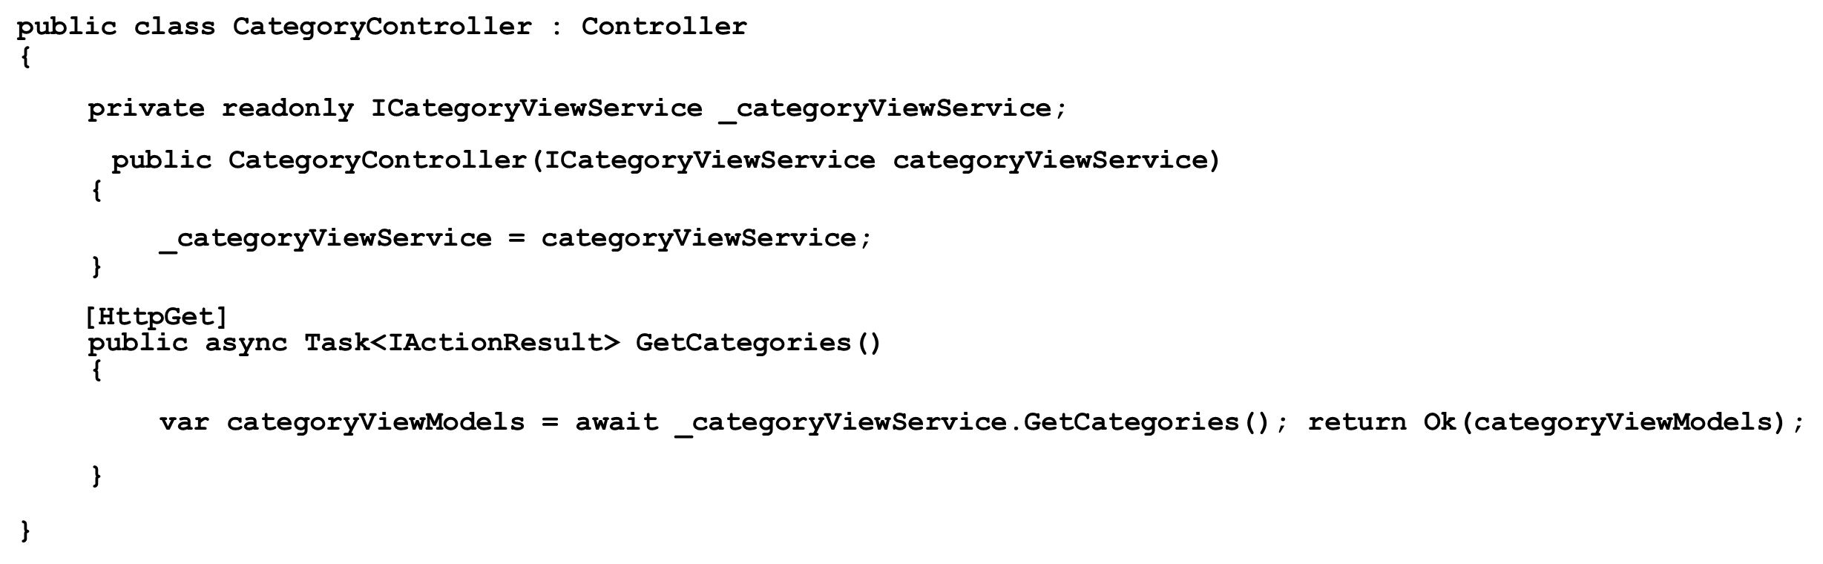
Using a View Service from the Controller

Slide 103
Using MediatR
Specific type for query or command
Controller sends via MediatR
Handled in the Core project through RequestHandler
Really lightweight controllers

Slide 104
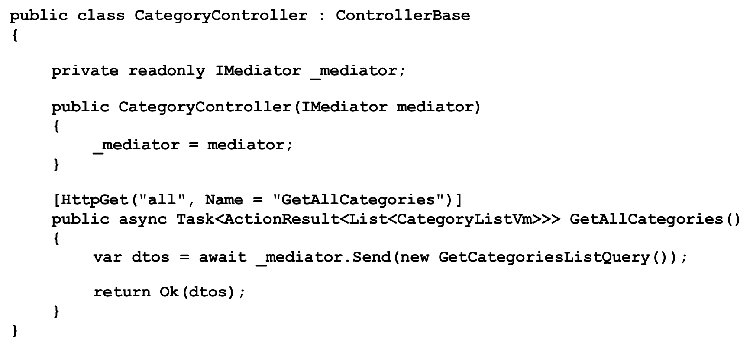
Controllers Using MediatR

Slide 105
New Request
We’ll need to need to export the list of events also to a CSV file?”

Slide 106
Exposing the API Functionality Using Swagger

Slide 107
Adding Swagger
API description
Specification
JSON or YAML
Tooling
Swashbuckle
NSwag (clients)

Slide 108
Required Packages
Swashbuckle
.AspNetCore
Swashbuckle
.AspNetCore
.Swagger
Swashbuckle
.AspNetCore
.SwaggerUI

Slide 109
Consuming the API in Client Application

Slide 110

Accessing the API
We can write all code manually for each type of client we’ll want to connect.

Slide 111

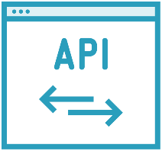

Using NSwag
Tooling based on Swagger/OpenAPI specification
Generation of client code to use the API
Works for many technologies including .NET Core and TypeScript

Slide 112
Using NSwag
C# code
API
Swagger
(json)
NSwag
TS code

Slide 113
NSwagStudio
Install NSwag Studio
https://github.com/RicoSuter/NSwag/wiki/NSwagStudio
Use to create TypeScript Output for Angular
https://github.com/RicoSuter/NSwag/wiki/TypeScriptClientGenerator-Angular

Slide 114
Service Lifetime

Slide 115
Service Lifetime
The lifetime of the service depends on when the dependency is instantiated and how long it lives. And lifetime depends on how we have registered those services.
Three Methods to define the lifetime of the services:
AddTransient
Transient lifetime services are created each time they are requested. This lifetime works best for lightweight, stateless services.
AddScoped
Scoped lifetime services are created once per request.
AddSingleton
Singleton lifetime services are created the first time they are requested (or when ConfigureServices is run if you specify an instance there) and then every subsequent request will use the same instance.

Slide 116
Testing

Slide 117







→
→

Slide 118




Why Do We Need Unit Tests?
Find bugs
Change without fear of breaking something
Improve quality
Documentation of the code

Slide 119

Integration tests
Test infrastructure code
Interaction between different layers
More work to set up
Often linked with database

Slide 120
Implementing Cross Cutting Concerns in the API

Slide 121
Handling Exceptions
Using custom exceptions
Defined in the Core project Derive from ApplicationException
Middleware in API
Converts the exception for use by the client

Slide 122

ASP.NET Core middleware
Component
Plugged into pipeline
Works on request or response
Can decide to shortcircuit the request
Order is important
Configured in Configure() of Startup

Slide 123
Middleware Request Pipeline
Request
Middleware component 1
Middleware component 2
Middleware component 3
Response

Slide 124
Writing Custom Middleware
public class RequestCultureMiddleware
{
private readonly RequestDelegate _next;
public RequestCultureMiddleware(RequestDelegate next)
{
_next = next;
}
public async Task InvokeAsync(HttpContext context)
{ ... }
}

Slide 125
Implementing Logging in the API

Slide 126
Steps to Enable Logging in the Application
Configure logging
Program.cs
Write log statements
Ilogger<T> in app code
Plug in Serilog
Configure in Program and
AppSettings.json

Slide 127



Logging in ASP.NET Core
Built-in logging API
Provider-based
LogLevel

Slide 128
Log Levels
Trace
Information
Error
Debug
Warning
Critical

Slide 129



Adding Serilog
NuGet package
Different log destinations
Structured logging

Slide 130
Implementing JWT in the API

Slide 131

API authentication
JWT token
Header of request
Different options exist
ASP.NET Identity
Identity Server
External provider
Use Built In [Authorize] Attribute

Slide 132
SERVER
ASP .Net Core
Web API
AJAX – account/getToken + U&P
BROWSER
(Stores the Token in Session Storage)
JSON with Token
AJAX – api/users + Read and attach Token
SQL
JSON

Slide 133
Angular Route Guards
CanActivate
Checks to see if a user can visit a route.
CanActivateChild
Checks to see if a user can visit a routes children.
CanDeactivate
Checks to see if a user can exit a route.
CanLoad
Checks to see if a user can route to a module that is lazy loaded.
Resolve
Persforms route data retrieval before route activation.

Slide 134
Secure Application using Route Guards
When user clicks the Admin Link, we need to verify that we have a token in session storage, and if the token in not there in the session storage, redirect the request to login component. (AuthGuard Custom RouteGuard)
AuthGuard uses AuthenticatorService, getToken() to get the token.
If token is undefined, the request is redirected to Login Component
If token is available, the request is allowed for Admin Component.
Logging and Token Management (Authenticator Service)
On Login Component, user must give username and password, which will be sent to API Server
If the username & password is correct, in the response, token will come from the Server
Received token will be stored in the session storage of the browser.
Reading and Attaching Token (TokenInterceptor Service)
Whenever the AJAX request is made for api/users, tokenInterceptor, intercepts and attaches token in the request header.
It uses authenticator service to read the token from session storage.

Slide 135

Contact Me
Manish Sharma | Gmail
Manish Sharma | WhatsApp
Manish Sharma | Facebook
Manish Sharma | LinkedIn

